Slide 1

Binary Convolutional Networks
Binary Convolutional Neural Networks
Filtering, Convolution and Gabor filters

Slide 2
Modulated Convolutional Networks
@article{GaborCNNs, title={Modulated Convolutional Networks
}, author={Wang, Xiaodi and Zhang, Baochang* and Li, Ce and han, jungong and Liu, Jianzhuang}, year={2018}, in proc. of IEEE CVPR. }
Notes:
今天我要讲一下我的论文，调制卷积神经网络
这个网络主要实现的是压缩功能，减少神经网络的存储空间
亮点是在压缩网络同时，保证了良好的性能

Slide 3



CONTEXT
about
about
about
Introduction
Modulated Convolutional Networks
Experiments

Slide 4
Introduction
AlexNet
Expensive computation
VGG
problems
Large number of parameters
DNNs
……
…...
ResNet
Large model size
Binarize filters
Compress models
Notes:
当前深度神经网络的高性能依赖于大量的参数量和高性能的硬件设备
近些年来智能便携设备越来越流行，比如嵌入式系统、用于人工智能的FPGA。
将深度学习中的高效方法应用于便携设备，将会显著提高设备上应用的性能。
然而智能便携设备的内存、电量、运算速度的条件限制都会成为将深度神经网络用于便携设备的挑战。

Slide 5
Introduction
Binaryconnect: Training deep neural networks with binary weights during propagations.(Binaryconnect)
Binarized neural networks: Training deep neural networks with weights and activations constrained to+ 1 or-1.(BNN)
Binary Networks
Xnor- net: Imagenet classification using binary convolutional neu- ral networks.(Xnor-Net)
Local binary convolutional neural networks. (LBCNN)
Notes:
主要对比算法

Slide 6
Introduction of Modulated neural networks
The M-Filters are employed to reconstruct the unbinarized filters, leading to a new architecture to calculate the CNNs model. The convolution operation is further improved by considering the intra-class compactness in the loss function, making the performance comparable to the full-precision model.
We manage to solve MCNs in an end-to-end framework. This highly compressed model outperforms all the state-of-the-art binarized models and is comparable to the well-known full-precision ResNets on CIFAR, MNIST, SVHN and 100-class ImageNet databases in terms of classification accuracy

Slide 7
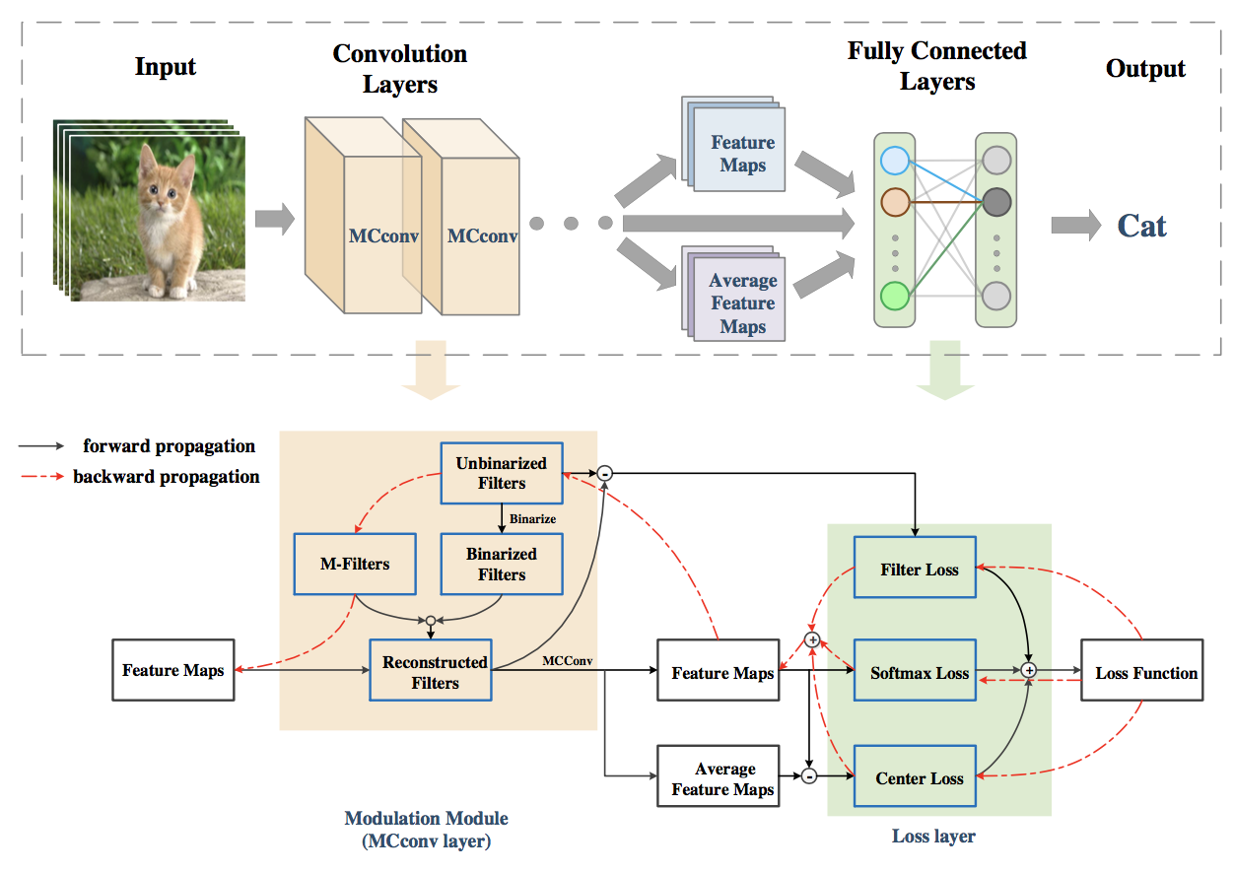
Modulated Convolutional Networks

Slide 8
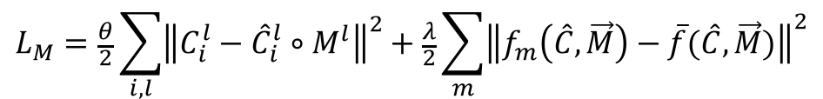
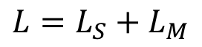
Modulated Convolutional Networks
--Loss Function
$$L=L_{S}+L_{M}$$
Softmax function
$$L_{M}=\frac{θ}{2}\sum_{i,l}{{\left\|C_{i}^{l}−{\hat{C}}_{i}^{l}∘M^{l}\right\|}^{2}+\frac{λ}{2}\sum_{m}{{\left\|f_{m}\left(\hat{C},\vec{M}\right)−\overline{f}(\hat{C},\vec{M})\right\|}^{2}}}$$
Filter loss
Center loss
Notes:
Centerloss: 测试时主要在图像识别分类上测试，可以学习每个类别的中心，使类内紧凑，从而提高图像分类的效果。从后面实验也可以看出，加上centerloss会略有提高

Slide 9
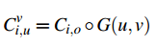
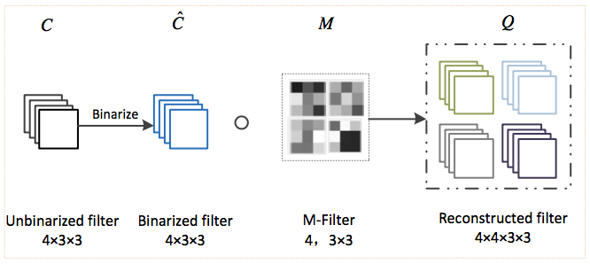
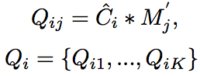
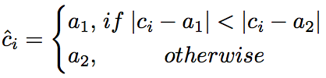
Modulated Convolutional Networks
Gabor CNNs
-- Forward Propagation with Modulation
Reconstructed Filters
Convolutional layer:
32✖️ compression
Encode
0，1
K-means
Notes:
一层只用一个4*3*3的调制核m-filter，所以最终卷积层达到接近32倍的压缩

Slide 10
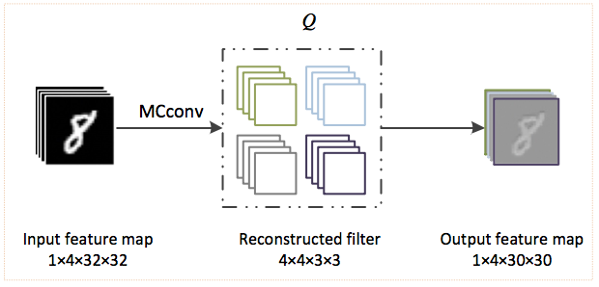
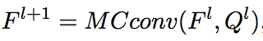
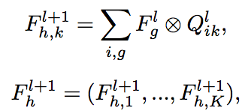
Modulated Convolutional Networks
-- Forward Propagation with Modulation
Forward convolution
h=1,g=1

Slide 11
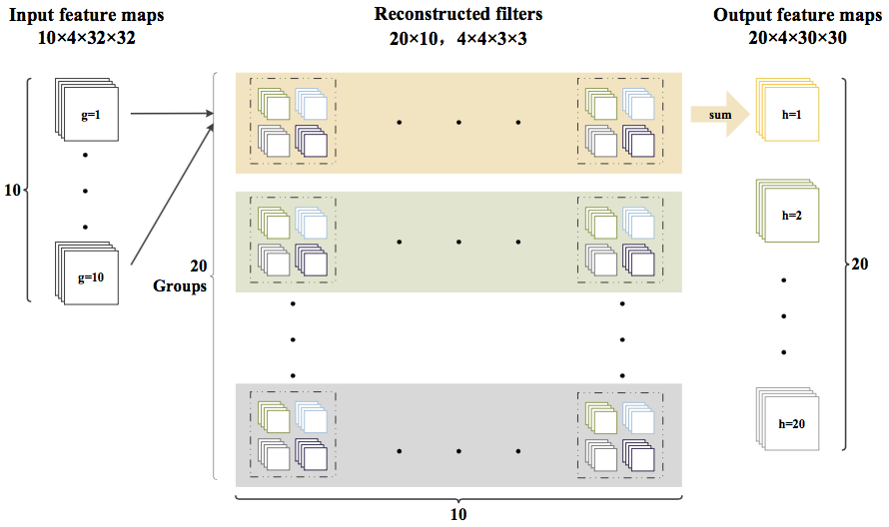
Modulated Convolutional Networks
-- Forward Propagation with Modulation
h=10,g=20

Slide 12
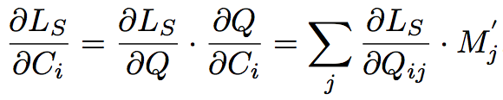
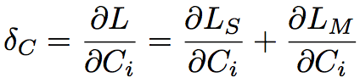
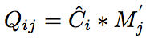
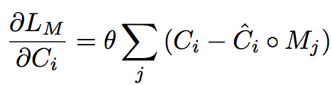
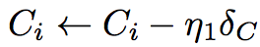
Modulated Convolutional Networks
-- Back-propagation Updating
Updating Unbinarized Filters

Slide 13
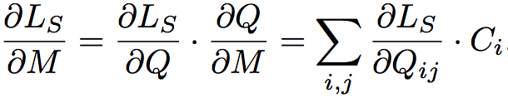
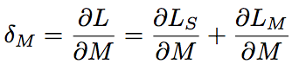
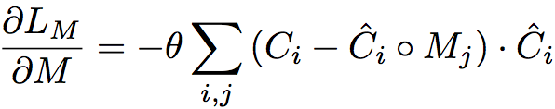
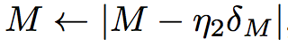
Modulated Convolutional Networks
-- Back-propagation Updating
Updating M-Filters
Notes:
每层先把unbinary filter更新完，再更新m-filter,一层只更新一个m-filter

Slide 14
Experiments
--Datasets
MINIST
CIFAR-10／100
SVHN
100-class ImageNet

Slide 15
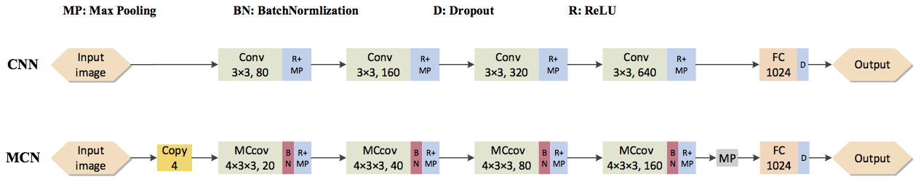
Experiments
--Network Structure
Base on CNN
Evaluated on MNIST

Slide 16
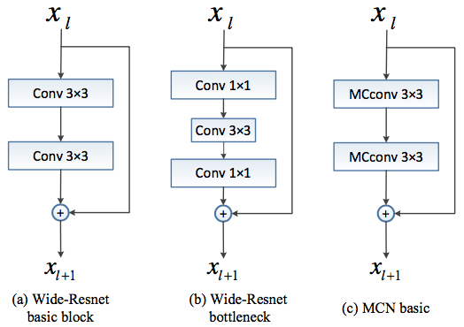
Experiments
--Network Structure
Base on Wide-ResNet
Evaluated on CIFAR10/100,
SVHN,
100-class ImageNet

Slide 17
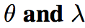
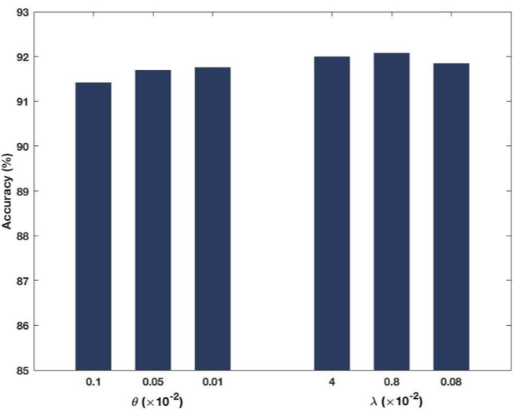
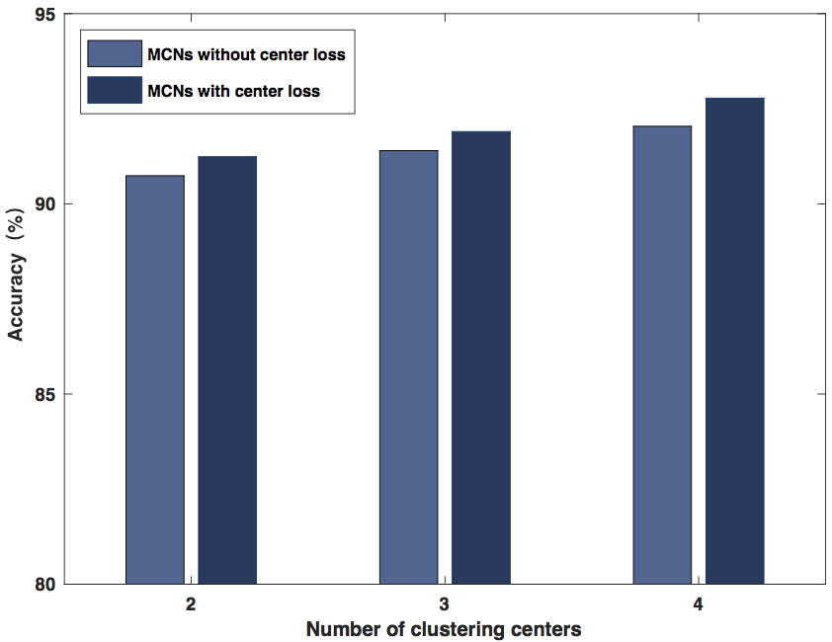
Experiment
--Parameters Evaluation
Notes:
实验的网络结构是20层的，16-16-32-64的MCN，在cifar数据集上测试的

Slide 18
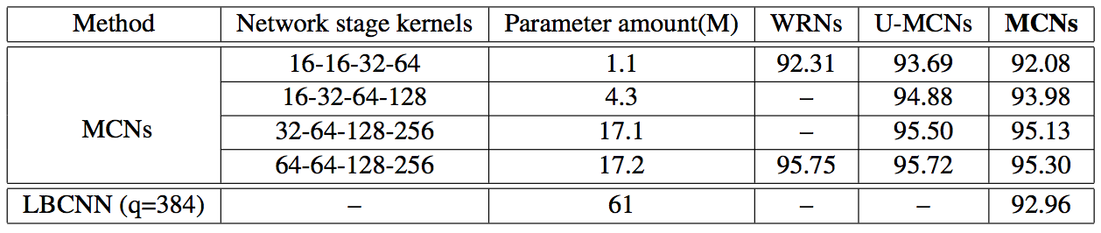
Experiment
--U-MCNs and MCNs
Notes:
重点：未二值化和二值化后，性能下降比较小，
与LBCNN之间的参数量对比

Slide 19
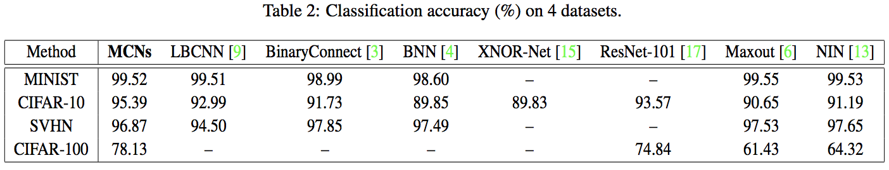
Experiment
--Results on MINST, SVHN, and CIFAR-10/100
Notes:
加入网络结构，MNIST上的结构是宽度是20-40-60-80的4层的MCN
SVHN上结构是28层的基于wideresnet结构的MCN, stage设置为64-64-128-256
CIFAR10/100上的结构类似于SVHN，不同的是深度为34层

Slide 20
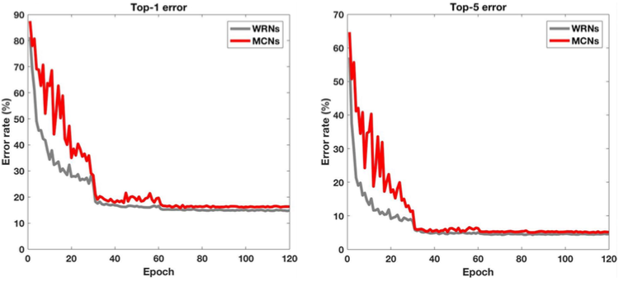
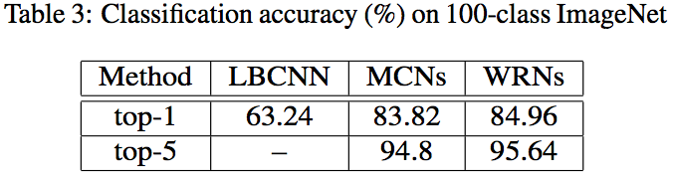
Experiment
--Results on 100-class ImageNet
Testing error curves for the 100-class ImageNet experiment
Notes:
imagenet上的网络结构是基于Wideresnet的34层的网络，stage是32-64-128-256 mageNet项目是一个用于视觉对象识别软件研究的大型可视化数据库。超过1400万的图像URL被ImageNet手动注释，以指示图片中的对象;在至少一百万个图像中，还提供了边界框。ImageNet包含2万多个类别; [2]一个典型的类别，如“气球”或“草莓”，包含数百个图像。第三方图像URL的注释数据库可以直接从ImageNet免费获得;但是，实际的图像不属于ImageNet。自2010年以来，ImageNet项目每年举办一次软件比赛，即ImageNet大规模视觉识别挑战赛（ILSVRC），软件程序竞相正确分类检测物体和场景。 ImageNet挑战使用了一个“修剪”的1000个非重叠类的列表。2012年在解决ImageNet挑战方面取得了巨大的突破，被广泛认为是2010年的深度学习革命的开始。

Slide 21
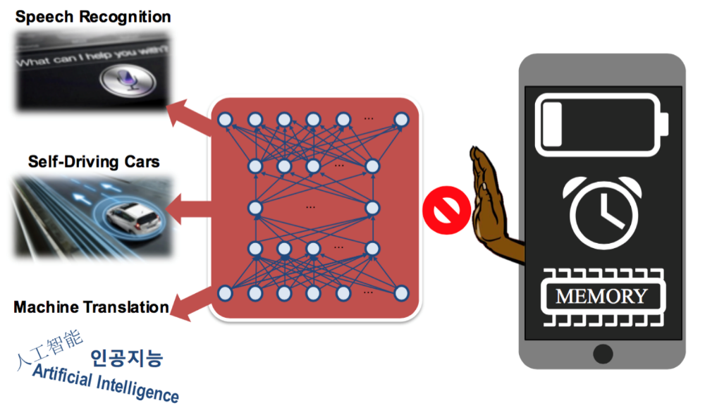
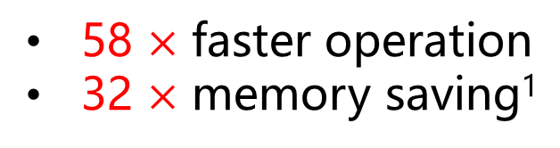
Projection Convolutional Neural Networks for 1-bit CNNs via Discrete Back Propagation
Why 1 bit convolution?
58 $×$ faster operation
32 $×$ memory saving¹
1. reported by XNOR-Net
Notes:
Another question is why we need 1 bit convolution. Convolution can be represented as a matrix multiplication operation. These can be quite expensive to implement and require many logic gates. This translates to requiring greater die area and also more power consumption.
So what happens in today, where we have so many edge devices – ranging from cellphones and watches to drones and glasses? These devices are much more limited in terms of size, power budget & memory capacity. Some of them cannot implement floating point operations efficiently.
In order to solve this problem, researchers started exploring CNNs which used lower precision activations and weights. As reported in XNOR-Net, 1-bit convolution can be 58 times faster and 32 times memory saving than traditional convolution.

Slide 22
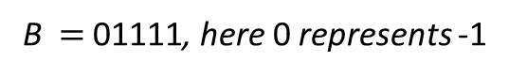
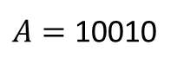

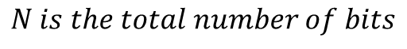
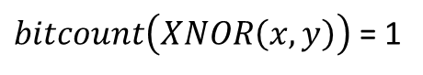
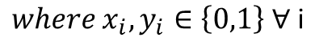
58 × faster convolution operation
i.e.
Dot product
$A=$ 10010
$$x⨀y=2×bitcount\left(XNOR\left(x,y\right)\right)−N$$
B $=$ 01111, here 0 represents -1
$${where x}_{i},y_{i}∈\left\{0,1\right\} ∀ \text{i}$$
Traditional product:
$$N is the total number of bits$$
$A⨀$B = (1*-1 )+(-1*1)+(-1*1)+(1*1)+(-1*1)=-3
Accelerated product:
$$XNOR\left(A,B\right)=00010$$
$bitcount\left(XNOR\left(x,y\right)\right)$ = 1
$$A⨀B\text{= }2×\text{1}\text{−}\text{5}\text{=}\text{−}\text{3 }$$
Notes:
Let's take a toy example to explain how it works. Dot product of 1-bit operands can be achieved by bitcount and XNOR operation, which is quite efficient. Given two number A and B, here 0 represents -1. If we use traditional product, the result will be minus 3. But we can first calculate the XNOR of A and B, and then use bitcount to get the final result, which is also minus 3.

Slide 23

32 × memory saving
To design specific AI chips
Model storage:
FP32 -> 1 bit
Notes:
As for memory saving, usually floating number takes 32 bits and our 1-bit convolution takes only 1 at the same case. Of course, we cannot apply this method on traditional chips and specific AI chips need to be designed.

Slide 24
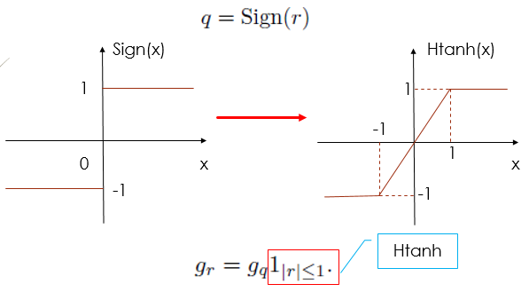
BNN
Forward: 1 bit
Backward: full-precision
STE: Straight-through Estimator
Courbariaux, M; et. al, Binarized neural networks: Training deep neural networks with weights and activations constrained to+ 1 or-1.
Notes:
The biggest problem in 1-bit CNNs is the non-differentiable sign function. In BNN, they treat it as a Hand tanh function. As a result, the gradient of it will be an indicator which is called STE or straight-through estimator. In the forward pass, both the weights and activations are binarized but they keep the backward pass full-precision.

Slide 25
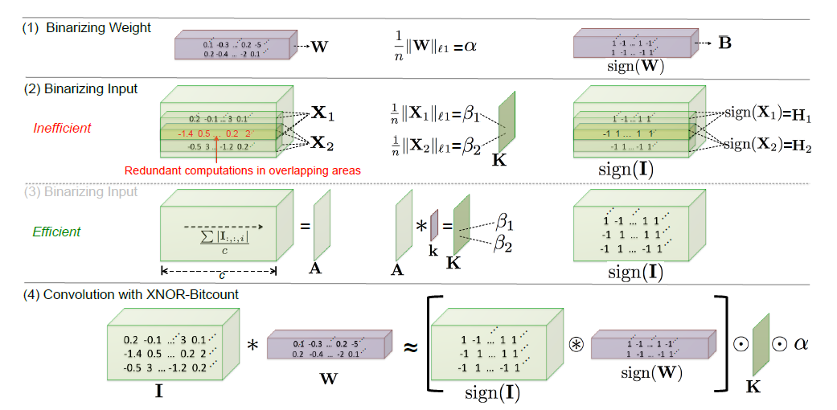
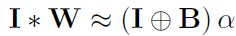
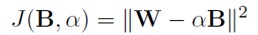
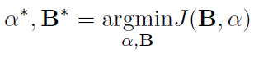
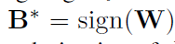
XNOR-Net
Rastegari, et.al., Xnor-net: Imagenet classification using binary convolutional neural networks.
Notes:
In XNOR-Net, they add a scalar alpha and a matrix K to reconstruct the weight W and input I respectively. They take l1-norm of W as alpha, which is proved to be optimal and K is finally aborted.

Slide 26
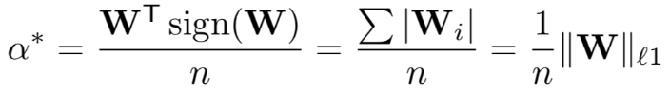
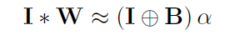
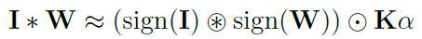
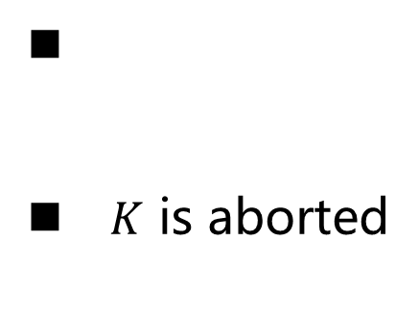
XNOR-Net
$K$ is aborted
Rastegari, et.al., Xnor-net: Imagenet classification using binary convolutional neural networks.
Notes:
In XNOR-Net, they add a scalar alpha and a matrix K to reconstruct the weight W and input I respectively. They take l1-norm of W as alpha, which is proved to be optimal and K is finally aborted.

Slide 27
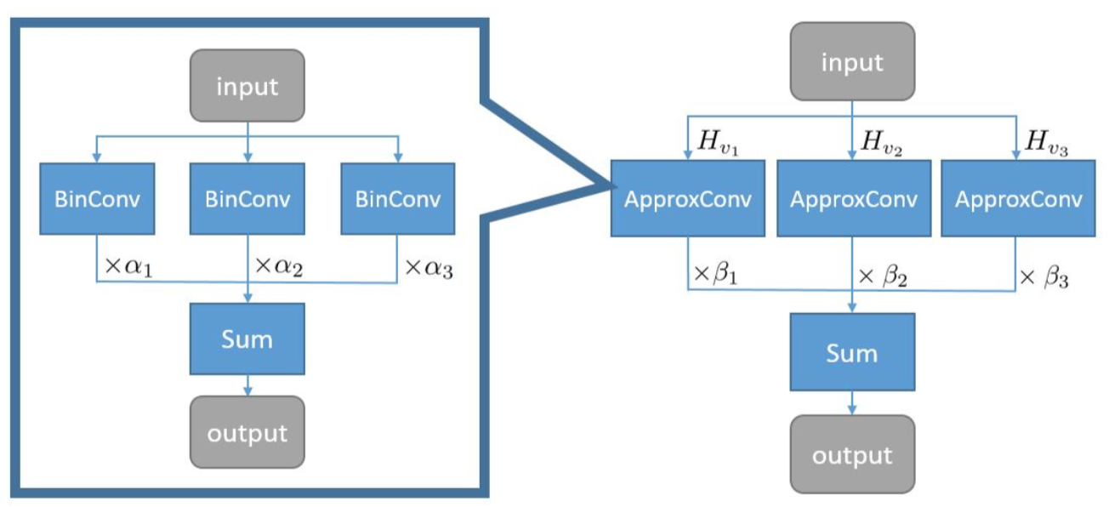
ABC-Net
Linear combination of multiple binary weight bases
Multiple binary activations
Lin, X et.al . Towards accurate binary convolutional neural network.
Notes:
In ABC-Net, they use linear combination of multiple binary weight bases and multiple binary activations to achieve better results.

Slide 28
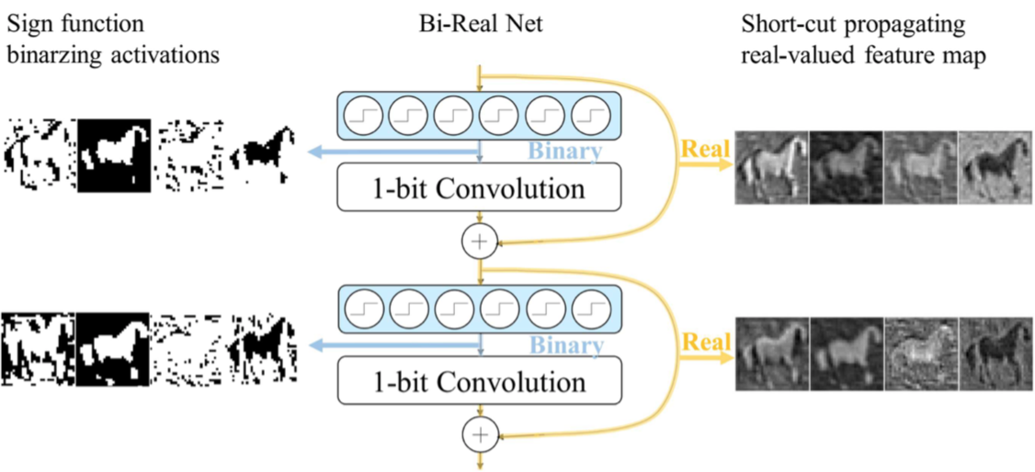
Bi-Real Net
Modified ResNet architecture
Approximation to the derivative of the sign function with respect to activations
Magnitude-aware gradient with respect to weights
Initialization: progressive training
Liu, Z.; et.al., Bi-real net: Enhancing the performance of 1-bit CNNs with improved representational capability and advanced training algorithm.
Notes:
Most recently, in bi-real net, they designed a modified resnet architecture and tried to approximate the derivative of the sign function. Besides, they achieved magnitude-aware gradient with respect to weights and initialized the network with proper pre-trained model.

Slide 29
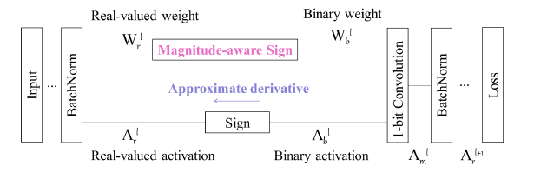
Bi-Real Net
Training process of Bi-Real Net
Liu, Z.; et.al., Bi-real net: Enhancing the performance of 1-bit CNNs with improved representational capability and advanced training algorithm.
Notes:
Most recently, in bi-real net, they designed a modified resnet architecture and tried to approximate the derivative of the sign function. Besides, they achieved magnitude-aware gradient with respect to weights and initialized the network with proper pre-trained model.

Slide 30
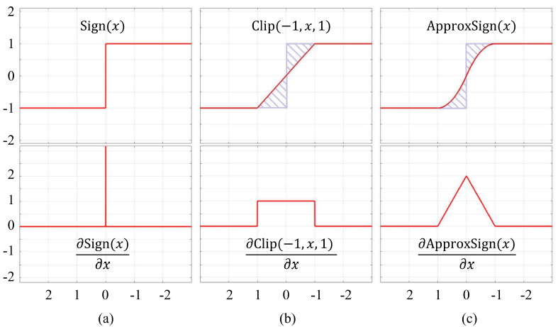
Bi-Real Net
Approximation to the derivative of the sign function
Liu, Z.; et.al., Bi-real net: Enhancing the performance of 1-bit CNNs with improved representational capability and advanced training algorithm.
Notes:
Most recently, in bi-real net, they designed a modified resnet architecture and tried to approximate the derivative of the sign function. Besides, they achieved magnitude-aware gradient with respect to weights and initialized the network with proper pre-trained model.

Slide 31

Accuracy degradation is large on ImageNet
Notes:
Despite so many methods, the accuracy degradation between 1-bit CNNs and full-precision ones are still hard to be ignored on large dataset like ImageNet.

Slide 32
Gabor Convolution Networks
Visualization of the first Convolution layer in Alexnet
2D Gabor Filter Bank
How about Gabor+CNN？
Luan, Shangzhen, et al. "Gabor convolutional networks." IEEE Transactions on Image Processing (2018).
Notes:
The first related method of our lab is Gabor convolution networks. If we visualize the first convolutional layer in Alexnet, some filters are quite like Gabor filters. So how about using Gabor filter to enhance the convolutional filters?

Slide 33





Gabor Convolution Networks
Convolutional Gabor orientation Filters (GoFs)
GCN convolution
Luan, Shangzhen, et al. "Gabor convolutional networks." IEEE Transactions on Image Processing (2018).
Notes:
Briefly, convolutional filters are modulated by a group of pre-fixed Gabor filters to obtain GoF, and then GoF along with input feature maps will do traditional convolution operation to get enhanced output feature maps.

Slide 34
Modulated Convolutional Networks
Wang, Xiaodi, et al. "Modulated Convolutional Networks." The IEEE Conference on CVPR (2018).
Notes:
Another related method of our lab is modulated convolutional networks. In this framework only convolution filters will be binarized and then reconstructed by a learned MFilters. Filter loss was developed in the process of back propagation.

Slide 35
Modulated Convolutional Networks
Reconstructed Filters
Encode
Convolutional layer:
32✖️ compression
0，1
K-means
Wang, Xiaodi, et al. "Modulated Convolutional Networks." The IEEE Conference on CVPR (2018).
Notes:
In MCNs, convolution filter are binary and MFilters are learned. It can compress the networks by 32 times in term of storage.

Slide 36


Projection
Convolutional
Neural
Networks
$$L=L_{s}+L_{P}$$
Layer-wise Projection loss
Notes:
For our PCNN. A new discrete back propagation via projection is proposed to build binarized neural networks in an end-to-end manner. Full-precision convolutional kernels C are quantized to be c hat via the projection. Due to multiple projections, the diversity is enriched. The resulting kernel tensor D is used the same as in conventional ones. Both the projection loss Lp and the traditional loss Ls are used to jointly train PCNNs in loss in the same pipeline. It can enrich diversity and thus improve the modeling capacity.

Slide 37





Projection
Optimization
Lagrangian method
Projection loss in CNNs
Parameters to be learned
Notes:
Well, let's find out more details. First of all, we define the projection aims to find the nearest discrete value for each continuous value. Then we want to minimize the target such as cross-entropy loss by searching for the an optimal set of discrete values. Based on the Lagrangian method, we obtain a new formulation. Finally, we regard the right part of the new object function as the projection loss. The projection parameter W and convolutional kernels are parameters to be learned. The hyper-parameter lambda is introduced to control the balance of these two losses.

Slide 38




Gradients of Parameters
Loss
Discrete Back Propagation
via Projection (DBPP) algorithm
Parameter
Notes:
How about the gradients of these two parameters? As we have two losses, both the two parameters can obtain gradients from cross-entropy loss and also projection loss, respectively. More specifically, the convolutional kernel C can get gradients from Ls and Lp. The same for projection parameter W. And we call this Discrete Back Propagation via Projection (DBPP) algorithm.

Slide 39
Summary
DBPP algorithm is proposed with multiple projections to learn a set of diverse quantized kernels
A projection loss is theoretically achieved in DBPP
PCNNs achieve the state-of-the-art results on ImageNet and CIFAR dataset
Notes:
So here are our contributions:
1. DBPP algorithm is proposed with multiple projections to learn a set of diverse quantized kernels
2. A projection loss is theoretically achieved in DBPP
3. PCNNs achieve the state-of-the-art results on ImageNet and CIFAR dataset

Slide 40


A close look at Lp
Discrete Value
continuous Value
$$L_{p}→0$$
Continuous values tend to converge to a set of nearest discrete values
Notes:
Let’s take a close look at projection loss. The left part of minus sign represents discrete values and the right part stands for continuous values. Theoretically, if Lp is optimized to be zero, the Continuous values tend to converge to a set of nearest discrete values. It will make the binarization process more stable.

Slide 41


Kernel weights distribution
Larger $λ$
Smaller Var.
MAV (discrete value)
Notes:
We verify this in an interesting experiment, where we visualize the kernel weights distribution of the first convolution layer of PCNN-22. When increasing lambda, the variance becomes smaller. Particularly, if we remove the projection loss, only one cluster is obtained, which could result in instability during binarization. The vertical dotted line stands for the mean absolute values, which are discrete.

Slide 42

Kernel weights distribution during training
Notes:
We also visualize the distribution of kernel weights in the process of training. We can see, as the training continues, the variance becomes smaller from the 2th epoch to the 200th epoch.

Slide 43

The most suitable 𝝀
Notes:
A natural question is: do we always need a large lambda? As a discrete optimization problem, the answer is no and the experiment can verify it. When lambda is set to ten to the power of minus four, we get an optimal balance and the accuracy is the best.

Slide 44

ResNet architecture modification
BN before Conv
1 Conv with 1 shortcut
Relu ->PRelu
Notes:
As for ResNet architecture modification, the BN layer is moved before the convolution layer. And one convolution layer with one shortcut is preferred. Also Relu is changed to Prelu.

Slide 45


Results on CIFAR and ImageNet dataset
Notes:
After all those improvements, we achieved the best results on CIFAR and ImageNet dataset. Furthermore, in this paper’s journal version, we report a new best top1 resnet eighteen accuracy, near to 60%, on ImageNet.

Slide 46

Memory usage and efficiency comparison
Negligible additional computation cost
Notes:
Finally, our method is almost the same as XNOR-Net in terms of memory usage and speed up. The additional computation cost is negligible and It’s hardware-friendly.

Slide 47



Experiments
The proposed RBCN over XNOR on tracking task and almost closes to the full-precision results.

Slide 48


Experiments
Table 6: Emotion classification accuracy(%) on fer2013
Dataset | Top1(best) | Full-Precision | 1-bit model
fer2013 | 71.2 | 71.38 | 69.82
Figure 10. Fer2013 dataset. Each column consists of faces of the same expression: starting from the leftmost column: Angry, Disgust, Fear, Happy, Sad, Surprise, Neutral.

Slide 49

Facial Landmark Localization
Notes:
Finally, our method is almost the same as XNOR-Net in terms of memory usage and speed up. The additional computation cost is negligible and It’s hardware-friendly.

Slide 50
Facial Landmark Localization
Notes:
Finally, our method is almost the same as XNOR-Net in terms of memory usage and speed up. The additional computation cost is negligible and It’s hardware-friendly.

